Slide 1

Credit One: Customer Demographics and Default Rates

Slide 2
Agenda
Business Questions
Why are we here? What are we trying to achieve?
Data Science Process Framework
Why BADIR’s framework?
Customer Demographic Data
Description of data, Where is the data from? How will this be cleansed and validated? Issues with the data.
Data Science Plan
How will we manage the data for the project?
Next Steps

Slide 3
Why are we here?
Credit One seeing an increase in the no. of customers defaulting on their loans
Credit One’s whole business relies on the accuracy of their credit scoring
Risk of losing business partners if this issue is not resolved
High pressure from business partners
Problem needs to be addressed without delay to limit risk of losing business partners and irreversible reputable damage
Notes:
What are the business goals?

Slide 4
Business Goal:
To gain a better understanding of how much credit to allow some to use and whether someone should be approved or not:
How can we limit the number of ‘at-risk’ customers?
Are there certain customer traits that might relate to whether or not a customer is likely to default on their current credit obligations?
Can we use these attributes to predict ‘at-risk’ customers who are likely to default on their current credit obligations?

Slide 5
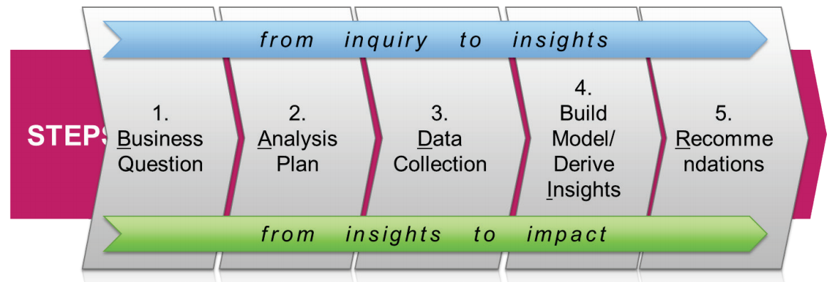
Data Science Process Framework
Following BADIR 5 steps from "data to decisions"™ framework.

Slide 6
Why BADIR Framework?
Business- friendly, hypothesis-driven analysis plan
Focuses on the business as the end goal
Why we are doing the analysis? Why information is useful for the business? What can they do with this information?
Using hypotheses is easy for the business to understand
Recommendation section is key to explaining and summarizing analysis plan and findings to the stakeholders in terms that they can understand and in alignment with information that they will value
Zumel and Mount focuses more on the data science aspect
More tailored to tech savvy stakeholders
Although useful for the initial analysis, most of the focus is on the model itself which may be difficult when communicating findings and recommendations to the business stakeholders
Not likely that the business will understand or even want to understand the modelling process – just want to know what the current problem is and how can we fix this to save money, which the BADIR framework addresses

Slide 7
Customer Demographic Data
Data provided by Credit One
Issues with validation:
Do not know where the data was collected
Do not know when the data is from
Do not know the population
Description
Response variable: ‘Yes’ or ‘No’ for defaulting on credit payments
23 variables cont. on next slide
Location
MySQL database

Slide 8
Cont.
Description
Response variable: ‘Yes’ or ‘No’ for defaulting on credit payments
23 variables:
X1: Amount of the given credit, including both the individual consumer and family’s supplementary credit
X2: Gender (male/female)
X3: Education (graduate school, university, high school, other)
X4: Marital status (married, single, divorce, other)
X5: Age (year)
X6-X11: History of past payment (no consumption, paid in full, use of revolving credit, payment delay, payment delay by months)
X12-X17: Amount of bill statement by month
X18-X23: Amount of previous payment by month
Y: Client’s behavior (default or not default)

Slide 9
Initial data insights
Cleaning is a crucial step in preparing data for analysis and predictive modeling
Need to ensure our data is correct, consistent and usable for our algorithms to work with
Ensures the quality of our data science plan
Credit One data is not currently in a ‘type’ that our model can process
Data type is currently usable, needs to be converted to numbers
We are seeing duplicate values that need to be removed

Slide 10
Data Science Plan
Identify which customer attributes relate significantly to customer credit limits and to build a predictive model that Customer One can use to better predict the amount of credit certain customers should be assigned, compared to previously implemented models
Collection
EDA
In-Depth Analysis
Visualizations
Reporting and Recommendations
Cleaning
Defining Business Goals
Analysis Goals, Hypotheses
Summarizing findings to communicate to business
Recommending how to move forward
Business Question
Recommendations
Analysis Plan
Important step for communication analysis findings to business personnel
More effective and easier to understand
Data already provided by Credit One
Data Collection
Insights
Predictive analysis:
Feature Selection
Machine Learning
Identifying and removing quality issues:
Removing null, N/A values
Dropping duplicates
Ensuring current data is all assign number values so our models can process the data
Exploratory data analysis
Visualizing, summarizing and interpreting information in the dataset
Thorough examination to gain an understanding of what information we are working with

Slide 11
Next Steps
EDA
Data collection, pre-processing and feature engineering
In-Depth Analysis
Predictive modelling and model selection
Cross validation
Train/test split method
Visualization
Presenting findings to business

